Slide 1
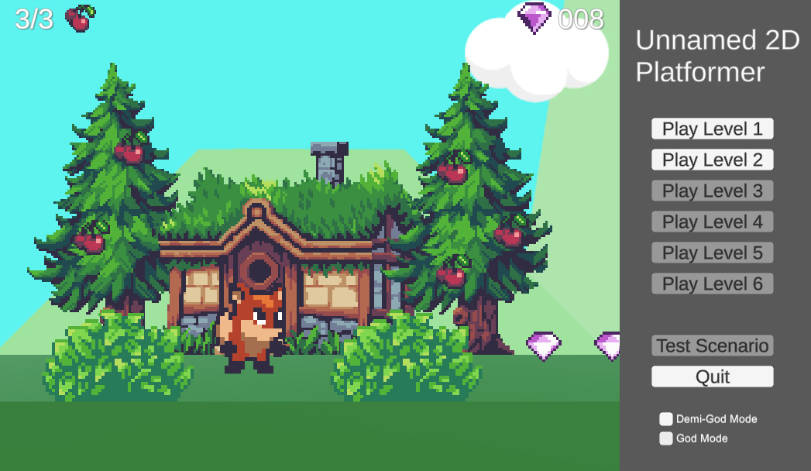
Unnamed 2D platformer Romero Pack
Cameron Bell
--
--

Slide 2
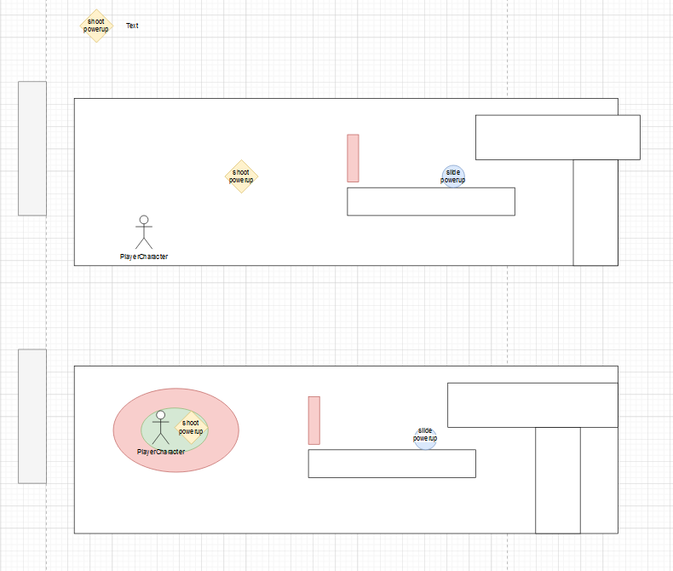
Paper Prototype
Initial rough idea
2D Platformer
Basic player movement(run, jump, crouch)
Power ups enhanced movement or combat vs terrain and enemies

Slide 3
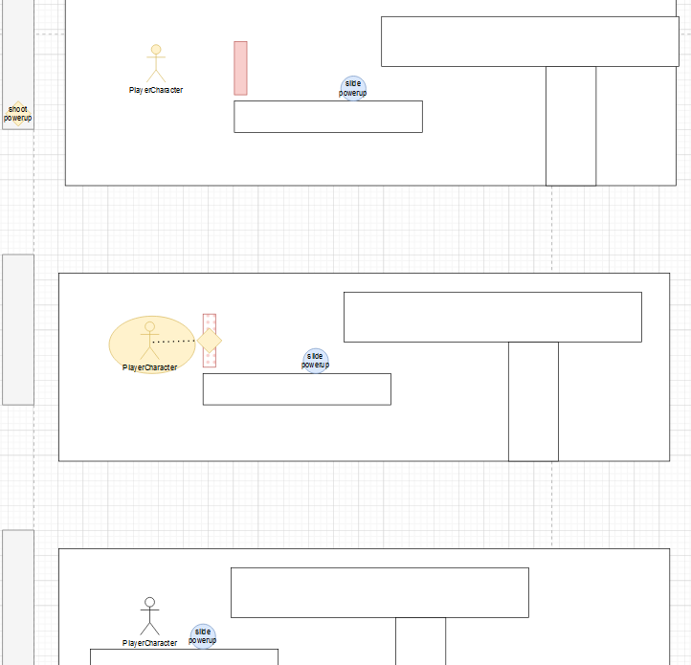
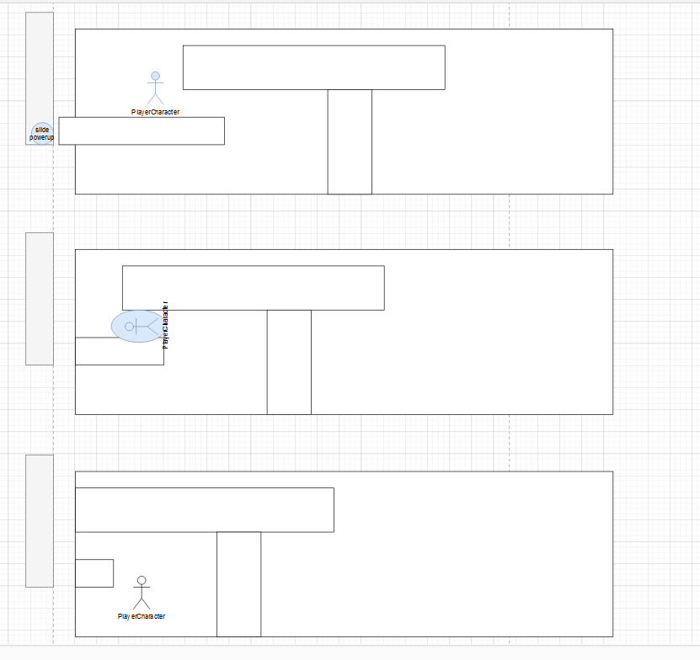
Paper prototype
…continued
Mobility here is slide and damage

Slide 4
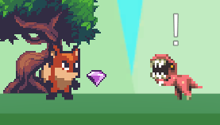
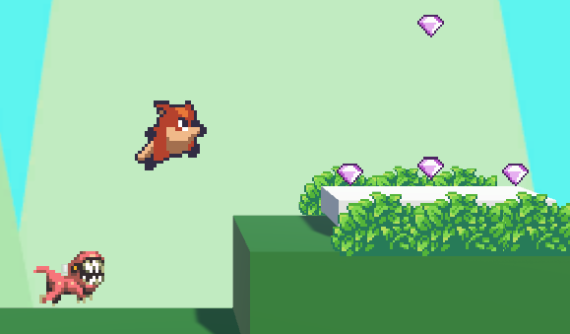
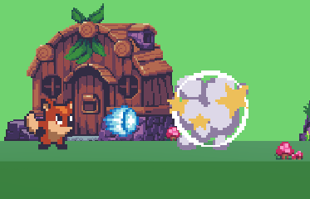
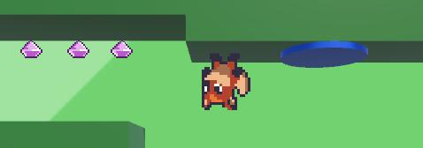
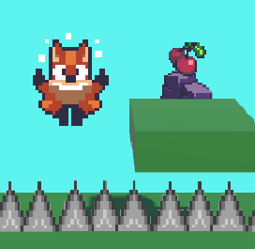
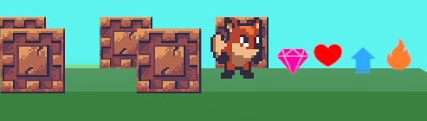
The Concept: A Basic 2D Platformer
Character can move left or right, jump and fall to traverse a level.
The main goal being to reach the level exit while collecting as many gems as possible.
The player will have to navigate the level, platforming over spike traps, along moving platforms.
There are enemies that will charge at the player when close, requiring the player to defeat them.
The player can choose one collectable powerup to gain an advantage.

Slide 5
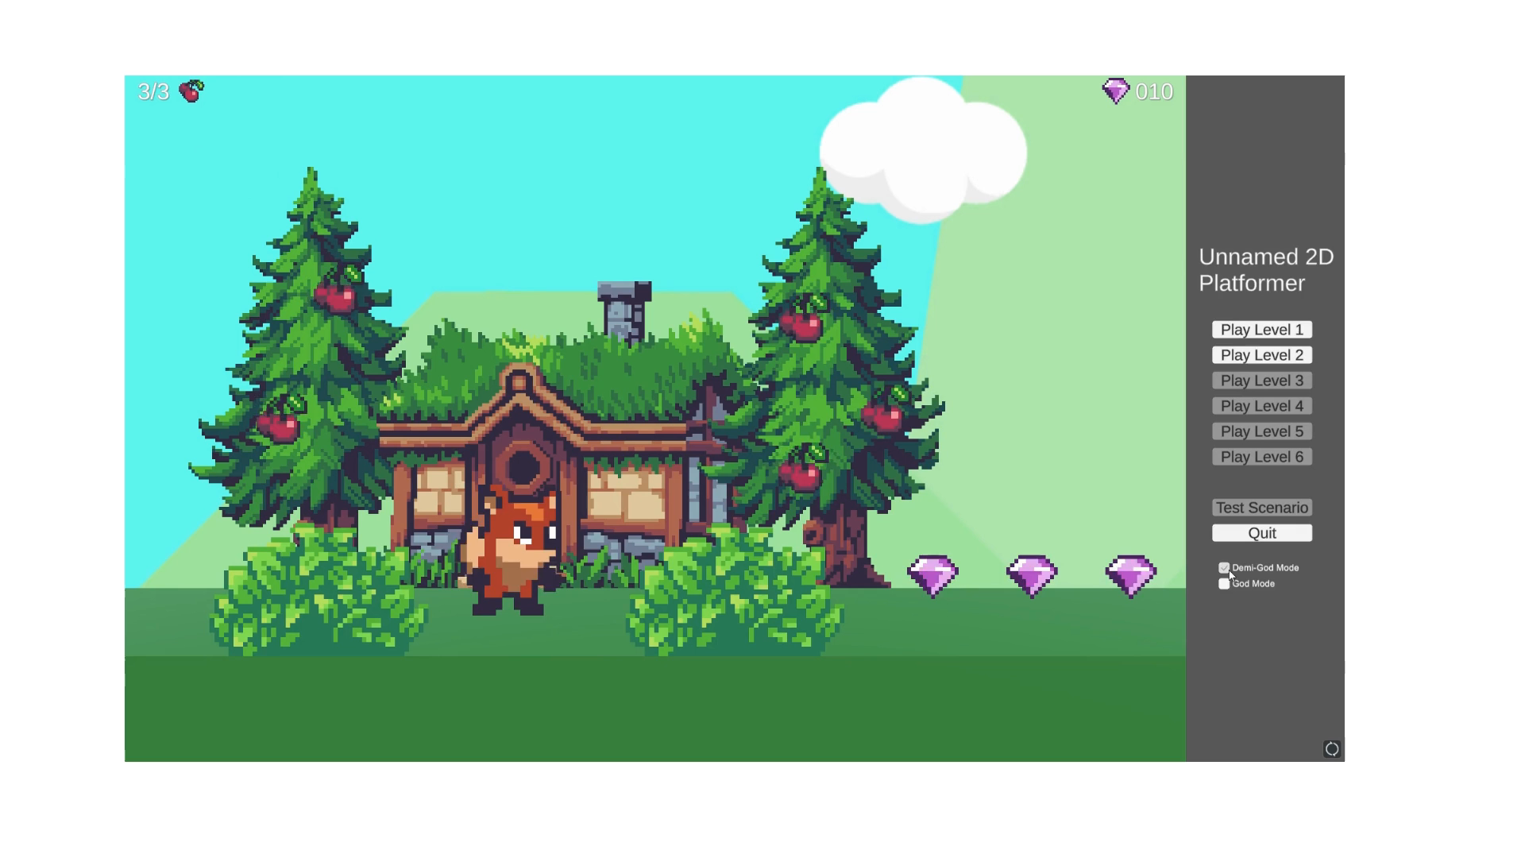
60 Second Video

Slide 6






Some Design Considerations
The platforming was designed to be easy and fluid, allowing the player to easily hop around the level, over obstacles, sliding down walls and wall jumping off to avoid traps.
The player has limited health to add difficulty and test their skill, however taking damage grants temporary invulnerability as to not make it too difficult.
The player can collect 1 of 4 power ups that can grant either double jump, fireball attacks, double health.
They can only use one at a time requiring them to choose carefully which ability they would like: offensive, defensive, mobility or no gameplay advantage in exchange for more gems (higher risk for higher reward).
The game was created using Unity.
Specifically Unity 3D, this was chosen to experiment with the idea of 2D sprites in 3d environment aesthetic.
The game was created primary with unity free store assets for the prototype. Mainly with the ‘Sunny Land’ asset pack along with icons from the ‘64 Flat Game Icons’ pack and art from the ‘Free Platform Game Assets’ pack.
https://assetstore.unity.com/packages/2d/characters/sunny-land-103349
https://assetstore.unity.com/packages/2d/gui/icons/64-flat-game-icons-36440
https://assetstore.unity.com/packages/2d/environments/free-platform-game-assets-85838

Slide 7
Thing for the full game.
Lots more polishing the base mechanics.
Create original assets or purchase higher quality assets that allow for more mechanics to be shown visually.
Add more powerups, enemies and levels to flesh the concept out more.
Experiment more with the art style and presentation, to do more with the 2D assets in the 3D environment.
More powerup interactions within the levels.

